Slide 1



Analyzing Energy Consumption During Menstrual and Non-Menstrual Days
Revna Demirkale 32056

Slide 2
Hypothesis
Energy expenditure decreases on menstrual days compared to non-menstrual days due to hormonal and psychological variations.

Slide 3



My Data
Pepapp
Apple Health

Slide 4
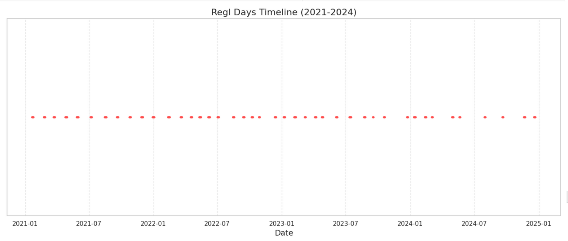

The graph below shows the Menstrual Days Timeline from 2021 to 2024
Regl Days Timeline (2021-2024)

Slide 5
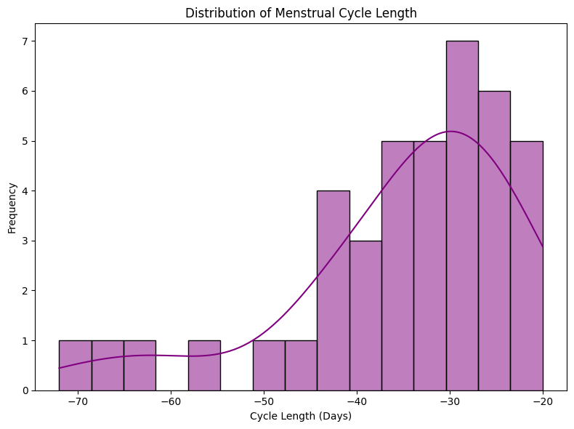
This visualization helps understand the variability and regularity of menstrual cycle lengths within the dataset.
Distribution of Menstrual Cycle

Slide 6





Apple Health Data Explanation
The data from Pepapp includes detailed menstrual cycle tracking information, specifically:
Start Date: The first day of the menstrual period.
End Date: The last day of the menstrual period.

Slide 7
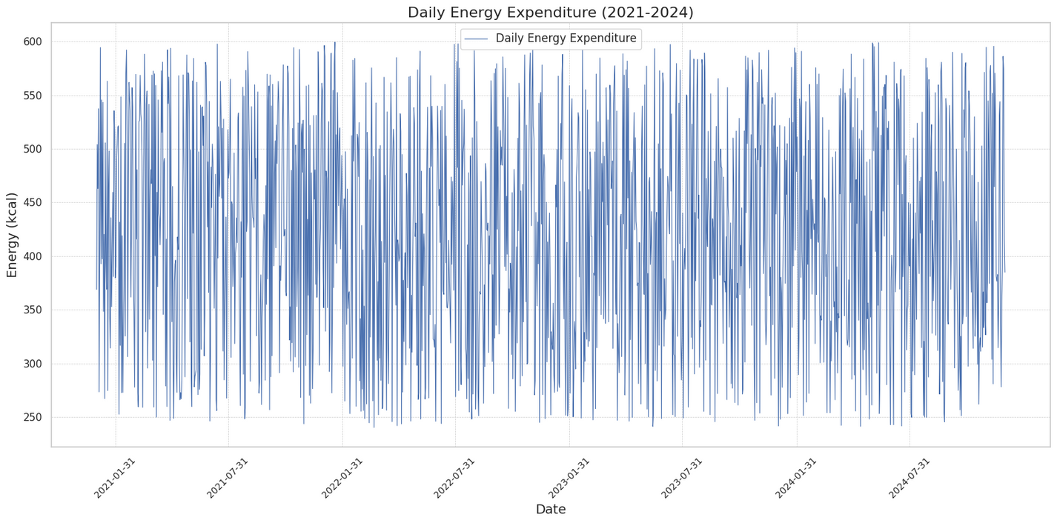
the complexity and high variability of the daily energy expenditure data, I aggregated the data into monthly averages for clearer analysis and visualization.

Slide 8
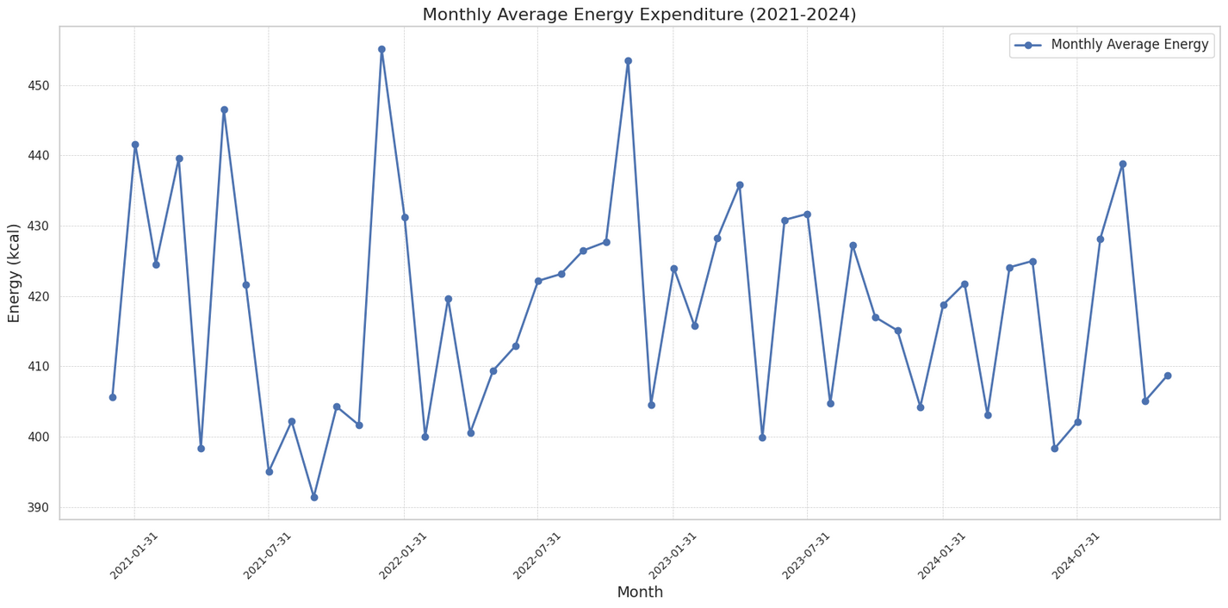
The graph below shows the monthly average energy expenditure calculated from step count data for the years 2021-2024.
Monthly Energy Expenditure (2021-2024)

Slide 9
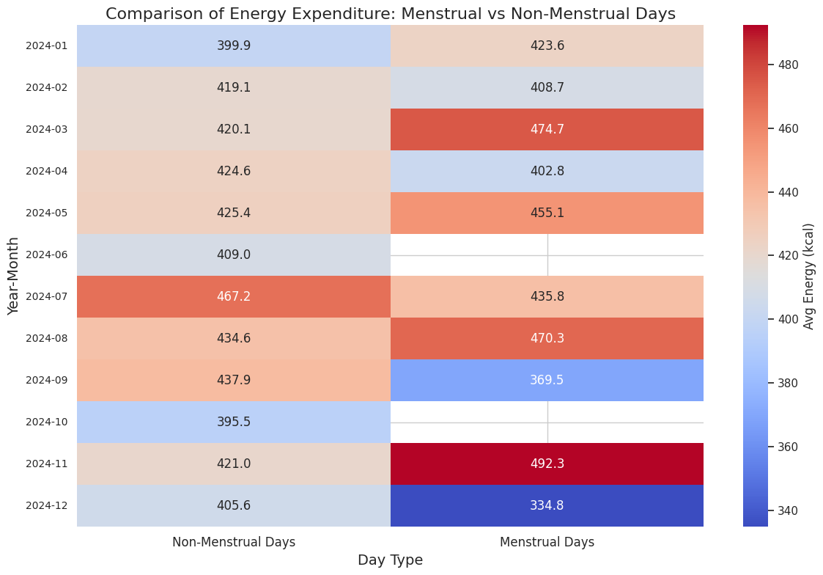
This heatmap illustrates the average energy expenditure across menstrual and non-menstrual days, grouped by month from 2021 to 2024

Slide 10
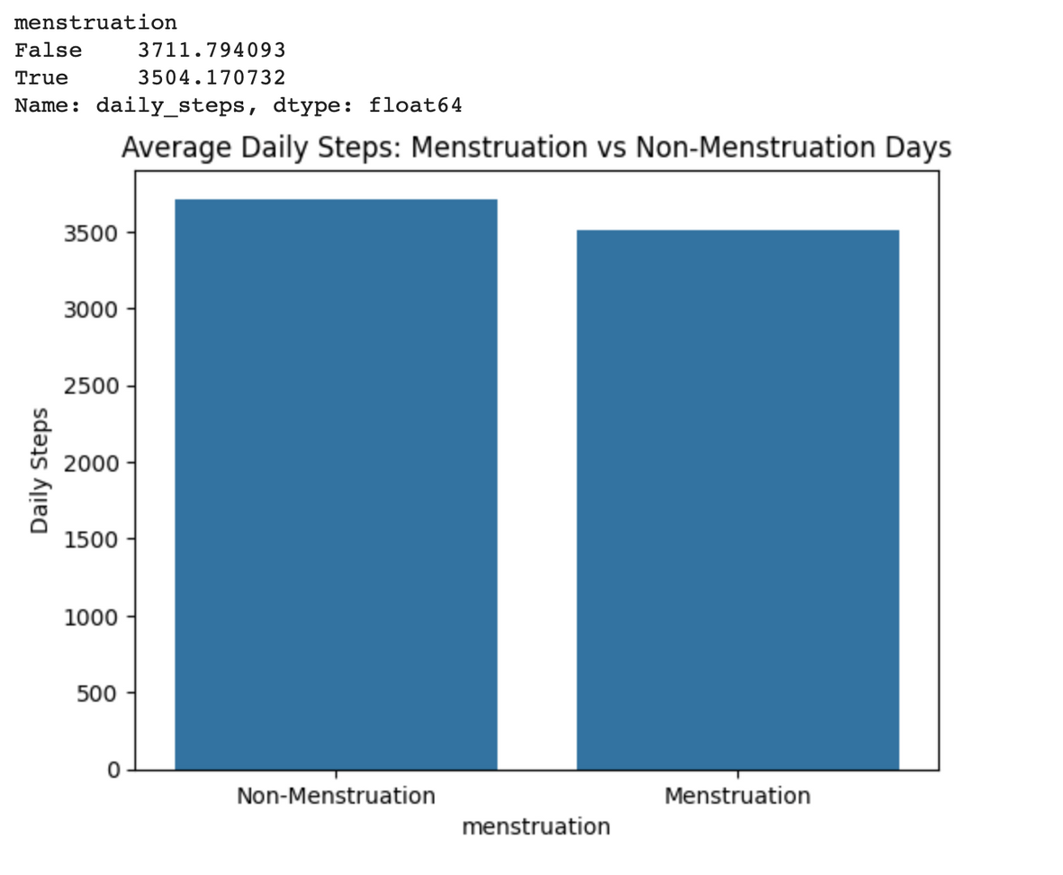
The data supports the initial hypothesis, indicating that energy expenditure is indeed lower during menstrual days.
For 3711 steps, approximately 148.44 calories are burned, and for 3504 steps, around 140.16 calories are burned, assuming 0.04 calories per step, indicating lower energy expenditure during the menstrual period.

Slide 11
This data shows that energy expenditure is lower during the menstrual period, aligning with my initial hypothesis. Therefore, the null hypothesis is not rejected.
According to my 4 years of data, energy expenditure decreases on menstrual days.

Slide 12


In addition to analyzing energy expenditure during menstrual and non-menstrual days, I also investigated the differences in energy expenditure between the Follicular Phase and the Luteal Phase of the menstrual cycle.
Follicular Phase
first half of the cycle, starting from the first day of menstruation to ovulation
Luteal Phase
second half of the cycle, after ovulation until the next menstruation

Slide 13
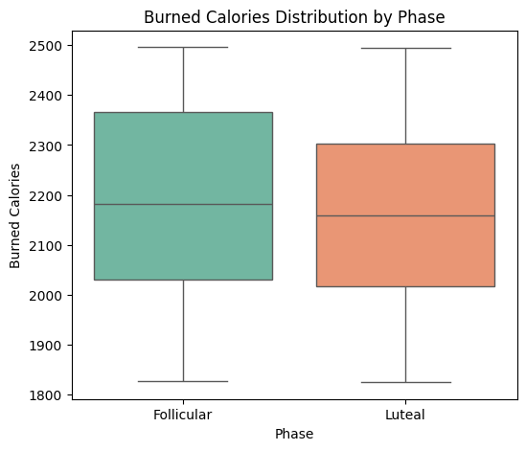
Follicular Phase
Energy expenditure during the folicular phase was higher due to increased metabolic activity driven by elevated progesterone levels. This phase prepares the body for a potential pregnancy, leading to higher resting energy expenditure and thermogenesis."

Slide 14
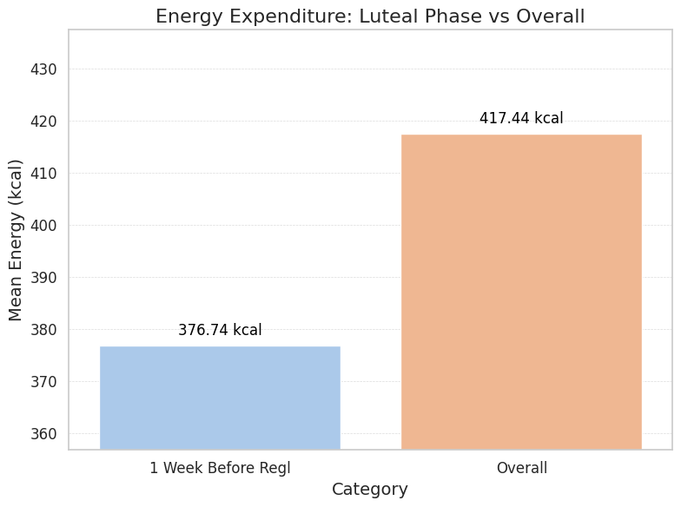
Luteal Phase
Energy expenditure during the luteal phase was lower compared to both the follicular phase and the overall average. This may be attributed to higher progesterone levels in the luteal phase, leading to fatigue, reduced activity levels, and metabolic changes.

Slide 15
Barr and Janelle's study, The Influence of Menstrual Cycle Phases on Energy Intake and Expenditure (Journal of Human Nutrition and Dietetics), highlights that energy expenditure tends to increase during the follicular phase and decrease in the luteal phase. The authors attribute these fluctuations to hormonal changes, with elevated estrogen levels enhancing metabolic activity during the follicular phase, while increased progesterone in the luteal phase leads to reduced energy output.
Barr, S.J., & Janelle, K.E. (Year). The Influence of Menstrual Cycle Phases on Energy Intake and Expenditure. Journal of Human Nutrition and Dietetics.
My data align with these findings, showing a similar trend where energy expenditure increased in the follicular phase and decreased during the luteal phase."

Slide 16
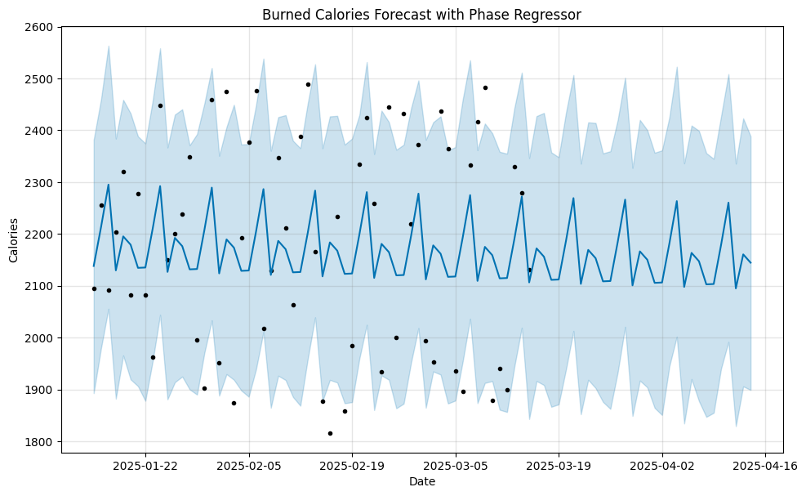
In this project, Machine Learning was applied, a robust time-series forecasting tool, to predict daily energy expenditure while incorporating phase-specific information. The goal was to model the relationship between menstrual phases and energy expenditure trends over time.

Slide 17
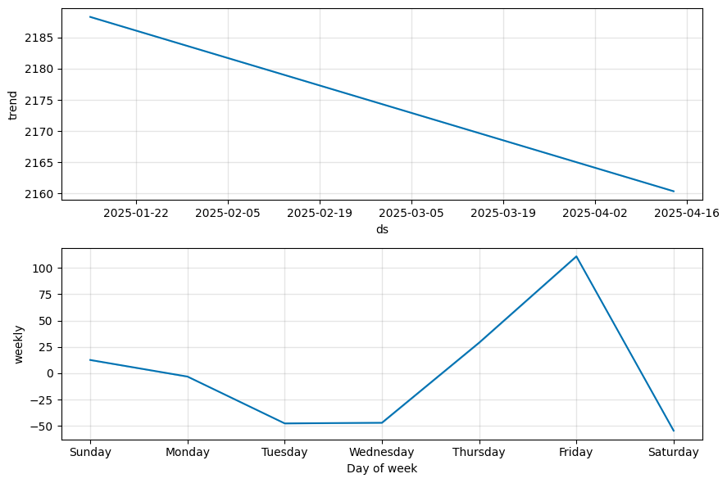
This visualization, generated with the Facebook Prophet model, breaks down the time series into its key components: trend and weekly seasonality. The trend indicates a gradual decline in energy expenditure over time, reflecting a long-term downward pattern. The weekly seasonality reveals consistent fluctuations, showing that energy expenditure peaks on Fridays and drops to its lowest levels on Tuesdays and Saturdays, likely influenced by recurring weekly routines or activities.

Slide 18
Thank you for your time

